Slide 1

Light Level Readings
Lesson 16

Slide 2
What the Lesson Will Cover
How the LEDs are used to take light sensor readings
How to respond to different readings

Slide 3
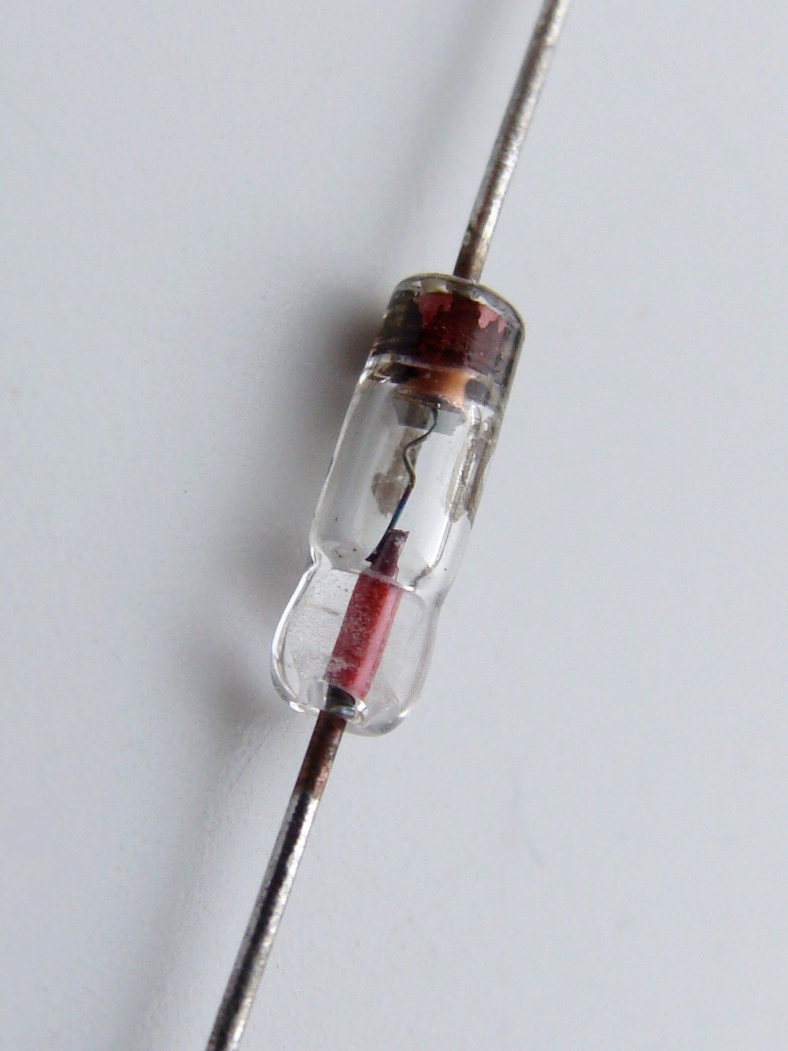
What Is a Diode?
A diode is a semiconductor, which means it has the ability to conduct electrical current.
Current is the flow of electrons
In an LED the electrons move around in a particular pattern.
In this set up, photons are released as a result of the electrons moving in a particular pattern.
Photons have energy and are the basic unit of light.
Therefore the diode emits light, it is a Light Emitting Diode.
This Photo by Unknown Author is licensed under CC BY-SA
Notes:
Talk through how a diode is used to create light

Slide 4
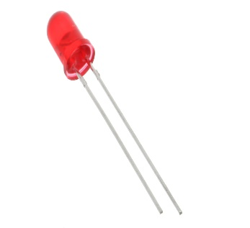
How Do LEDs Sense Light?
An LED is a simple diode
A diode is a device with two terminals, typically allowing the flow of current in one direction only
It is possible to insert an LED into a circuit as a photodiode
This means that it is capable of converting light into either current or voltage, depending upon the mode of operation
The micro:bit LEDs respond by holding a small amount of charge / current.
Notes:
Talk through how the LEDs sense light

Slide 5

How Do LEDs Sense Light?
The 25 LEDs on the micro:bit can produce light
However, the polarity can be reversed which means that the LEDs fill with a small amount of charge when light is present
This charge or current can be measured and then the micro:bit firmware responds with the light level reading
The more current, the more light
The less current, the less light
No current means no light, the LEDs are covered or you are in a pitch black room
Notes:
Talk through how the LEDs sense light

Slide 6
How to Take a Light Level Reading
from microbit import *
light = display.read_light_level()
display.scroll(light)
Notes:
Discuss with the learners what the program does.
Note the use of the variable on line two, what is it called?, what does it store?

